Slide 1
8086 Interrupt part 1 The Intel Microprocessors 8th Edition by Brey 6–4 INTRODUCTION TO INTERRUPTS
Md. Shafqat Talukder Rakin
Lecturer, Department of CSE,
United International University
Email id : shafqat@cse.uiu.ac.bd
Courtesy: Nasif M. Sir
Notes:
Brey book chapter 12 Interrupts ;
6–4 INTRODUCTION TO INTERRUPTS

Slide 2
What is Interrupt?
The meaning of ‘interrupts’ is to break the sequence of operation
While the CPU is executing a program, an interrupt breaks the normal sequence of execution of instructions, diverts its execution to some other program called Interrupt Service Routine (ISR)
After executing ISR , the control is transferred back again to the main program
An interrupt is an external event which informs the CPU that a device needs service.
In the 8086, there are a total of 256 interrupts (or interrupt types)
– INT 00
– INT 01
– …
– INT FF
03.05.07 4

Slide 3
Why need Interrupt?
The interrupt is used to get the processor’s attention.
In personal computer, interrupts are used to keep accurate time, read the keyboard.

Slide 4
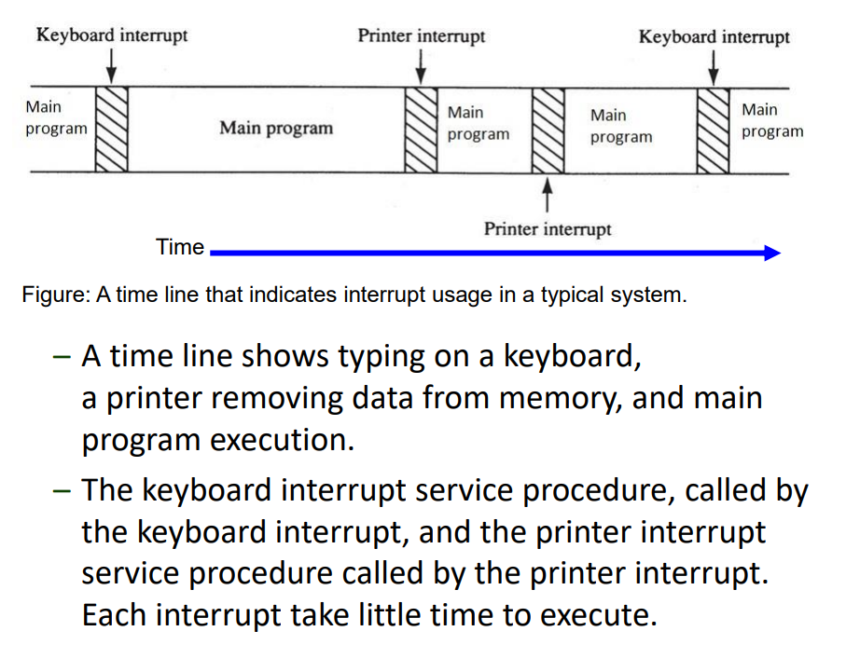

Slide 5
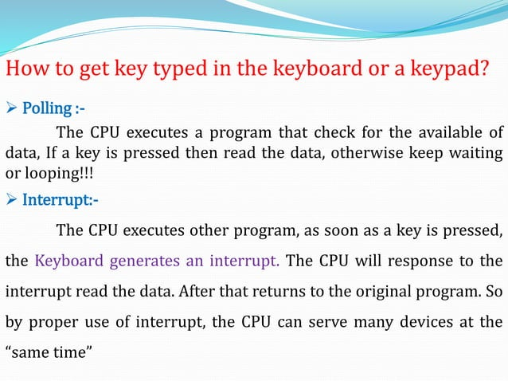

Slide 6
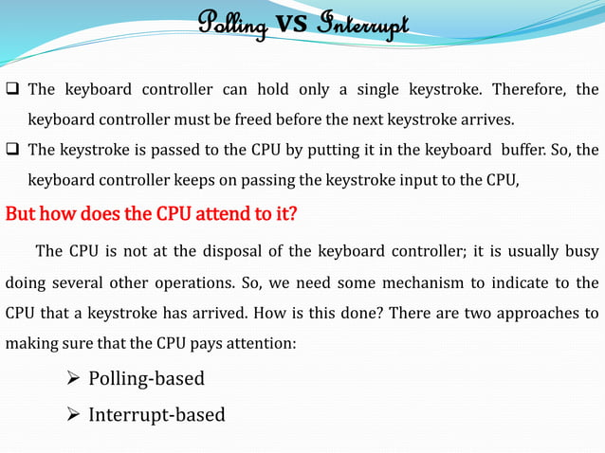

Slide 7
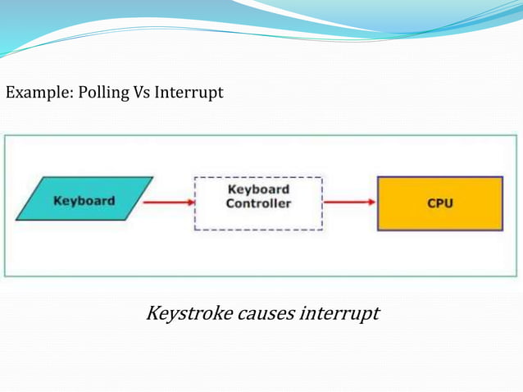

Slide 8
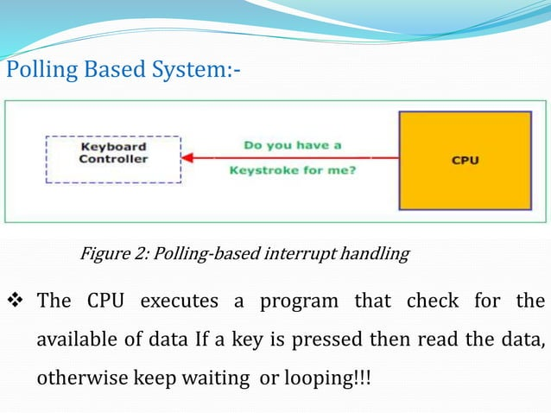

Slide 9
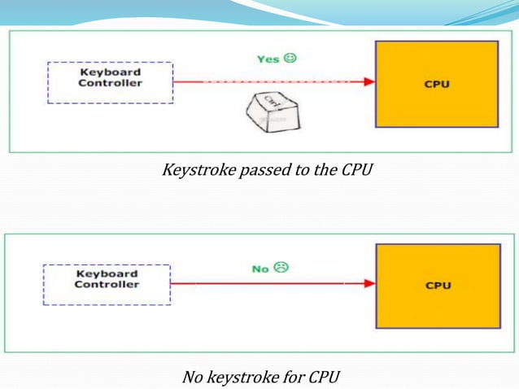

Slide 10
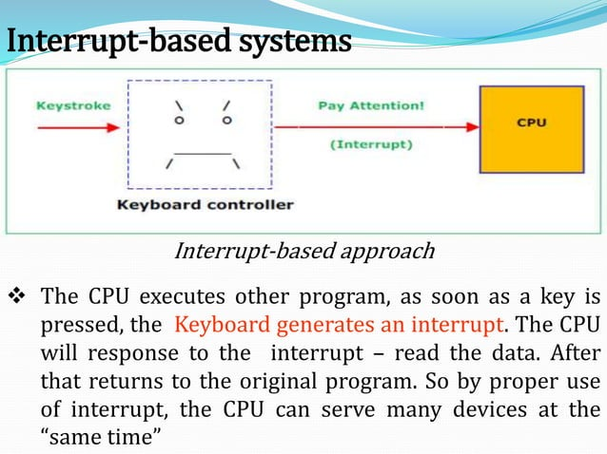

Slide 11
Types of interrupt
There are two types of interrupts
1. External interrupts/hardware interrupt
These interrupts are generated by external devices i.e out side the processor (using NMI, INTR pins). Eg: Keyboard interrupt.
2. Internal interrupts/software interrupt
It is generated internally by the process circuit or by the execution of an interrupt instruction. Eg: INT instruction, overflow interrupt, divide by zero interrupt. At the end of each instruction cycle, the 8086 checks to see if any interrupts have been requested.

Slide 12
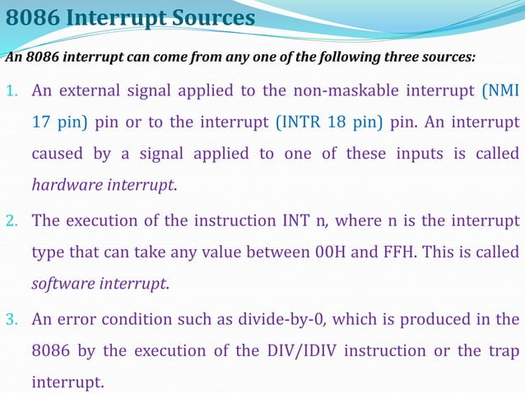

Slide 13
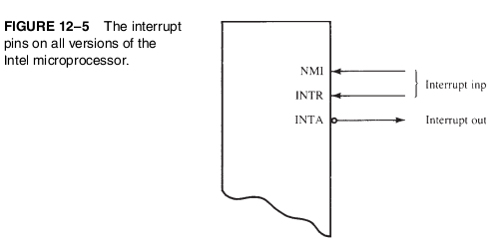
Interrupt pins

Slide 14
Hardware Interrupt
In 8086, interrupts pins are : 1. NMI 2. INTR 3. INTA
NMI :-- Non Maskable Interrupt input pin which means that any interrupt request at NMI input cannot to masked or disabled by any means.
INTR:-- It can be masked using the Interrupt Flag (IF).
INTA:--Interrupt Acknowledgement : It becomes active after the current instruction has completed execution.

Slide 15
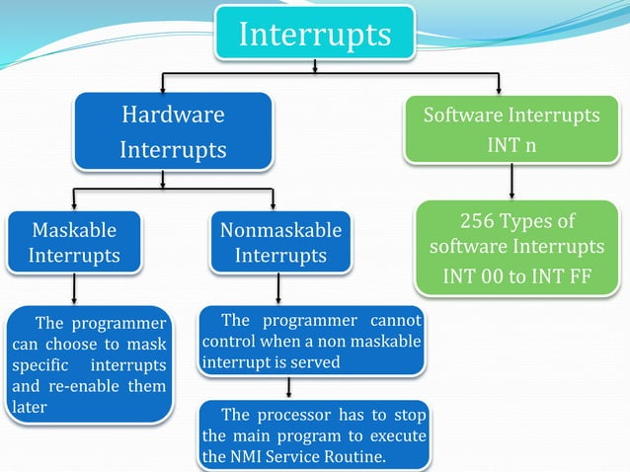

Slide 16
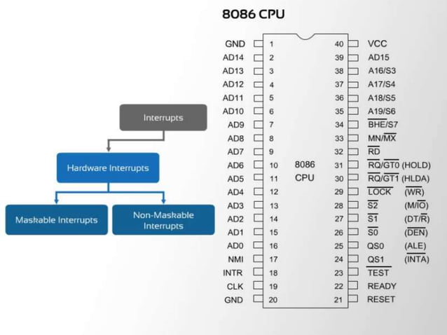

Slide 17
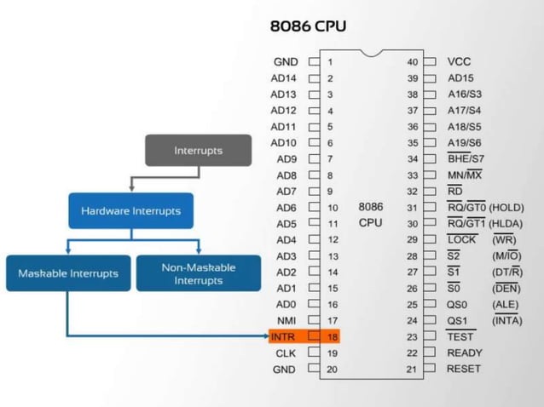

Slide 18
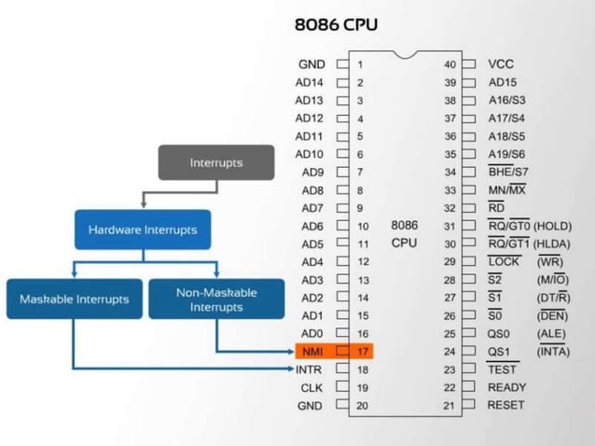

Slide 19
ISR –Interrupt service routine
While the CPU is executing a program, an interrupt breaks the normal sequence of execution of instructions, diverts its execution to some other program called “Interrupt Service Routine (ISR)” or Interrupt Service Procedure (ISP).
After executing ISR, the control is transferred back again to the main program which was being executed at the time of interruption.

Slide 20
Interrupt Vector Table (IVT)
The first 1Kbyte of memory of 8086 (00000 H to003FF H) is set aside as a table for storing the starting addresses of Interrupt Service Routine (ISR).
For every interrupt, there must be a program associated with it. This program is called ISR.
An interrupt vector is a 4-byte number. Each vector contains a value for IP (2 byte) and CS (2 byte) that forms the address of the interrupt service procedure. An interrupt vector is a pointer to where the ISR is stored in memory.
Since 4-bytes are required for storing starting addresses of ISPs, the table can hold 256 Interrupt procedures.
Therefore the table is referred as Interrupt Vector Table. The purpose of the IVT is to hold the vectors that redirect the microprocessor to the right place when an interrupt arrives.
In this table, IP value is put in as low word of the vector & CS is put in high vector.

Slide 21
ISR vs. IVT
ISR (Interrupt Service Routine) : Desired function/ program of an interrupt.
Interrupt vector: Address of an interrupt.
IVT (Interrupt Vector Table) : Interrupt vector for 256 interrupts.

Slide 22
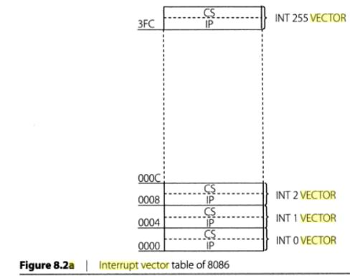

Slide 23
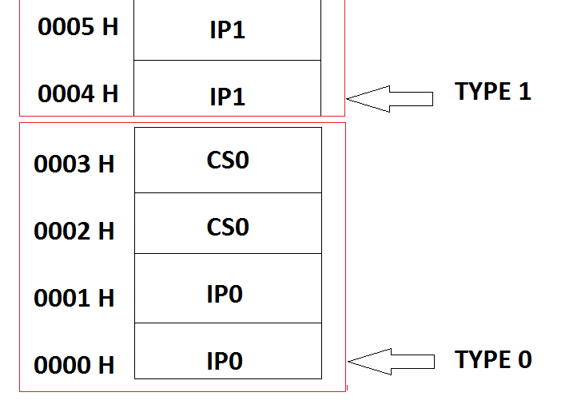
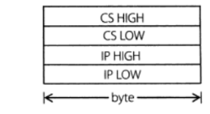

Slide 24
Interrupt Vector Table
INT Number Physical Address
INT 00 00000
INT 01 00004
INT 02 00008
: :
: :
INT FF 003FC

Slide 25
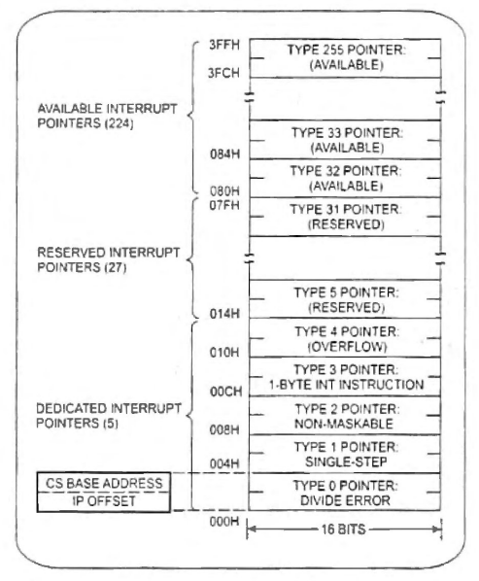
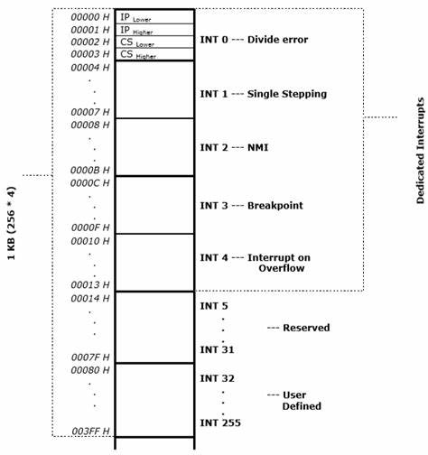

Slide 26
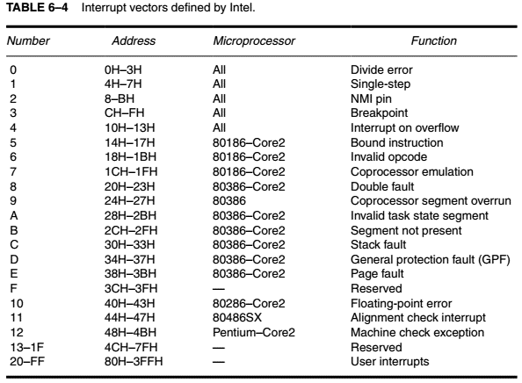

Slide 27
Interrupt vector
0-4 are reserved vectors.
Some of the reserved vectors are for errors that occur during the execution of software, such as the divide error interrupt.
Intel reserves the 5-31 interrupt vectors for the other microprocessor products. The remaining interrupt vectors (32–255) are available for the user.
The lower the vector number, the higher the priority.
Interrupt goes to the memory location that is four times the value of the interrupt number

Slide 28
# Calculate the memory address/location for the interrupt INT CH in the interrupt vector table.

Slide 29
Microprocessor get correponding entry on interrupt vector table by multiplying interrupt number with 4h.
CH * 4H = 30H
0030H and 0031H location contains IP in the Interrupt vector table.
0032H and 0033H location contains CS in the Interrupt vector table.

Slide 30
# Calculate the memory address/location for the interrupt INT 5H in the interrupt vector table.

Slide 31
Microprocessor get correponding entry on interrupt vector table by multiplying interrupt number with 4h.
5H * 4H = 14H
0014H and 0015H location contains IP in the Interrupt vector table.
0016H and 0017H location contains CS in the Interrupt vector table.

Slide 32
The operation of real mode interrupt
Whenever a software interrupt instruction executes, the following sequence of events occurs:
1. The contents of the flag register are pushed onto the stack.
2. Both the interrupt (IF) and trap (TF) flags are set to 0 . This disables the INTR pin and the trap or single-step feature.
3. The contents of the current code segment register (CS) are pushed onto the stack.
4. The contents of the current instruction pointer (IP) are pushed onto the stack.
5. The interrupt vector contents are fetched, and then placed into both IP and CS so that, the next instruction executes at the interrupt service procedure addressed by the interrupt vector.
If another interrupt event occurs during your servicing of the initial interrupt you don't want to lose that interrupt notification.
Notes:
TF: single step execution; If another interrupt event occurs during your servicing of the initial interrupt you don't want to lose that interrupt notification.

Slide 33
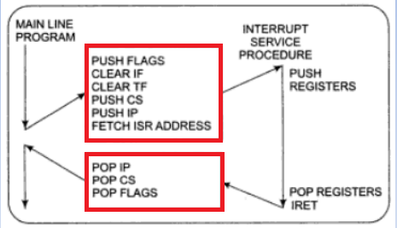
Response to an Interrupt
i. PUSH FLAGS
ii. Disables the 8086 INTR interrupt input by clearing the interrupt (IF) in the flag register
iii. It resets the trap flag (TF) in the flag register
iv. PUSH CS
v. PUSH IP
vi. It does an indirect far jump to the start of the procedure written to respond to the interrupt

Slide 34
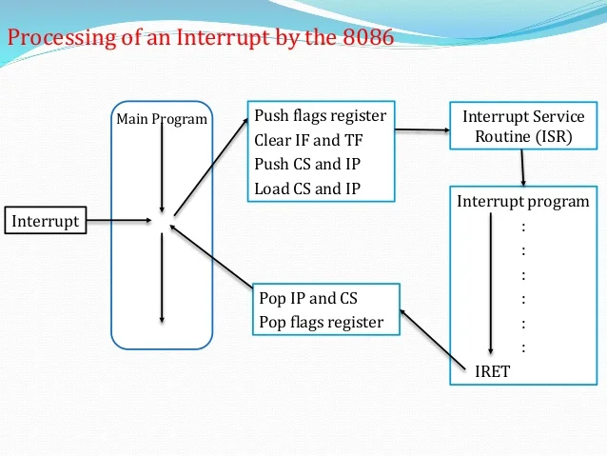

Slide 35
Stack PUSH
Push the instruction pointer (IP)
Push the code segment (CS)
Push the flags register (FR)
Stack

Slide 36
Stack POP
SP
Pop the instruction pointer (IP)
SP
Pop the code segment (CS)
SP
Pop the flags register (FR)
SP
Stack
03.05.07 7

Slide 37
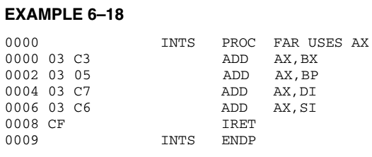
An Interrupt Service Procedure

Slide 38
Thank You

